Slide 1

♧ Fundamentals of Artificial Intelligence
ScamLens AI
AI-Assisted Scam Detection and Risk Analysis System
Domain: Fundamentals of AI
Name : Gayathri Jayam S
Roll No: 240701142
1

Slide 2

♧ Fundamentals of Artificial Intelligence
ABSTRACT
Scam Detection
Identifies potential scams by analysing suspicious messages, emails, and URLs
ScamLens AI is an AI-assisted web application designed to identify potential online scams by analysing suspicious messages, emails, and URLs. The system uses pattern matching and rule-based reasoning to detect the suspicious
Indicators and asses the level of risk
It generates a risk score and classifies
The input into different risk levels, along with explanations of detected warning signs and safety recommendations. The project aims to improve user awareness and support online communication through an understandable and accessible scam analysis system.
Risk Analysis
Uses pattern matching and rule-based reasoning to detect warning signs and calculate risk levels
Safety Recommendations
Provide explanations and precautions to help user recognize and avoid scams
2

Slide 3

♧ Fundamentals of Artificial Intelligence
Software and
Hardware Requirements
› Software
› Hardware
›
Visual Studio Code
›
Intel Core i3 or equivalent
›
Python with Flask
›
Minimum 4 GB RAM
›
Google Chrome
›
At least 1 GB free storage
3

Slide 4
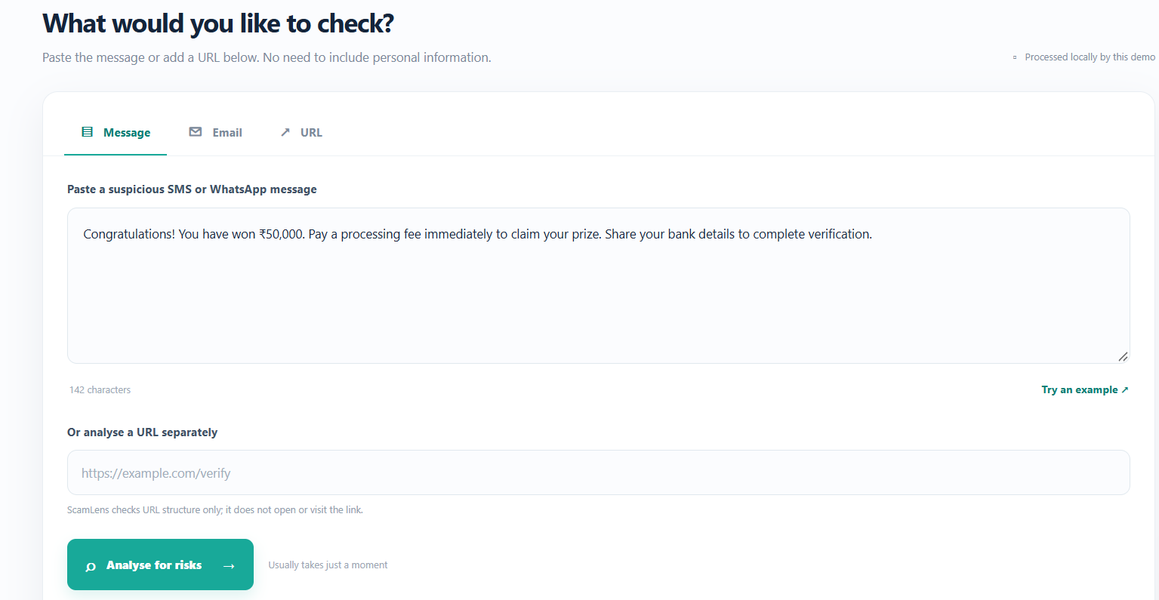
♧ Fundamentals of Artificial Intelligence
FULL VIEW OF THE PROJECT
Presents the overall interface and major functionalities of ScamLens AI.
4

Slide 5
Sampe Coding
♧ Fundamentals of Artificial Intelligence
SAMPLE CODING
Example logic for rule-based analysis of suspicious input.
def analyze_message(message):
keywords = ["urgent", "password", "verify", "prize"]
score = 0
for word in keywords:
if word in message.lower():
score += 20
if score >= 40:
return "High Risk"
elif score >= 20:
return "Moderate Risk"
return "Low Risk"
Pattern Match
Finds suspicious words .
Risk Analysis
Calculates Risk Score.
5

Slide 6
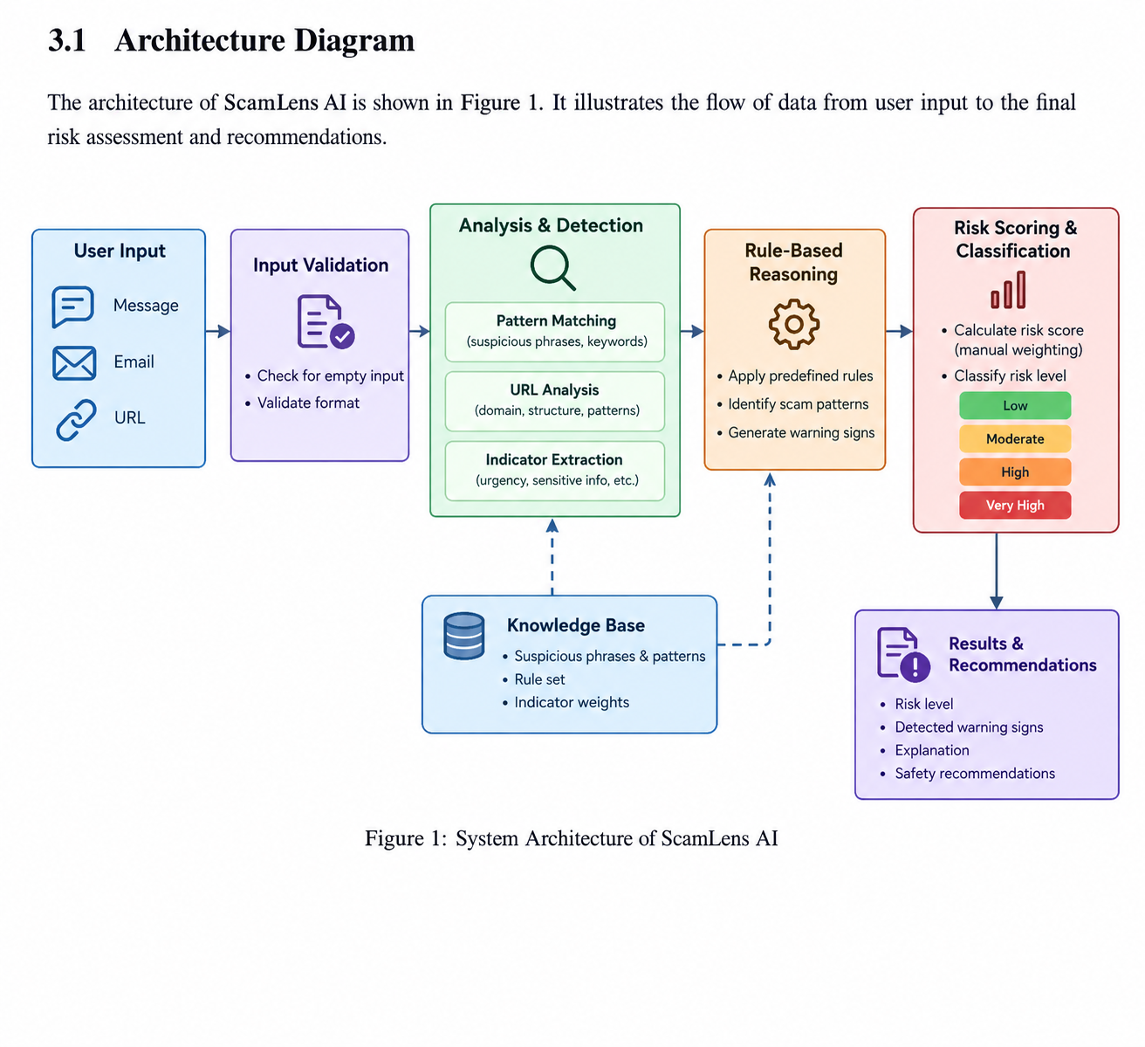
♧ Fundamentals of Artificial Intelligence
ARCHITECTURE DIAGRAM
The main parts of the current browser-based prototype are shown below.
The architecture diagram illustrates the workflow of ScamLens AI, from input collection and suspicious indicator detection to risk assessment and the generation of safety recommendations.
6

Slide 7
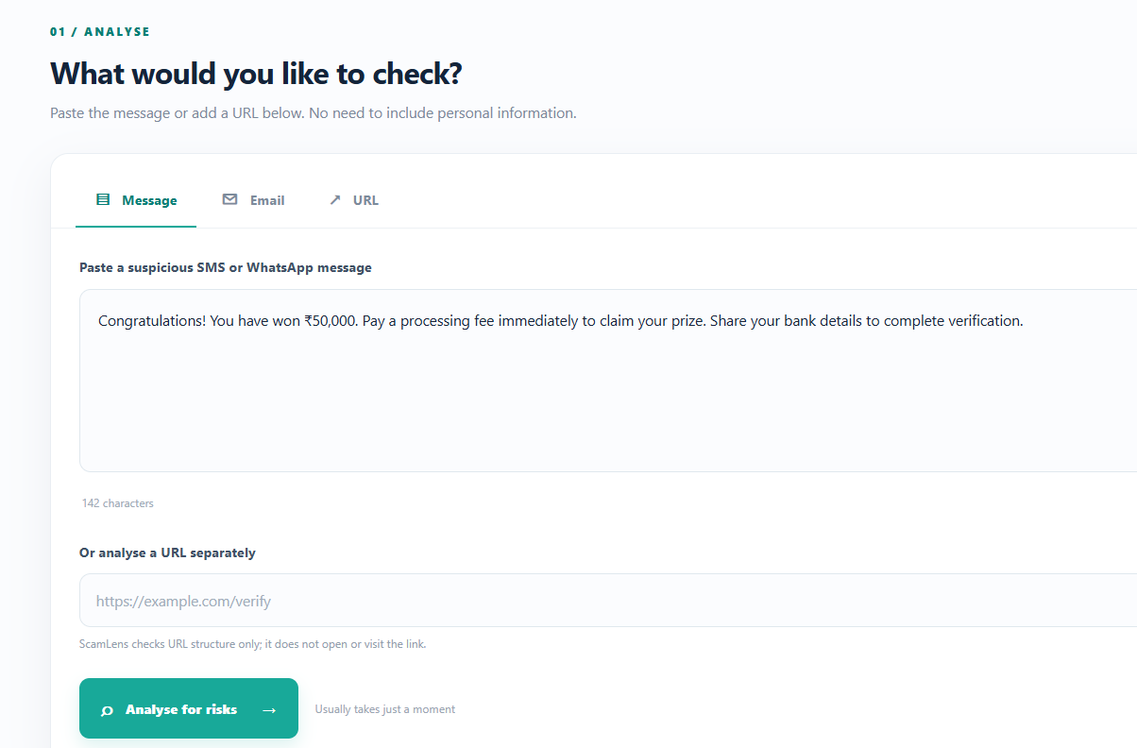
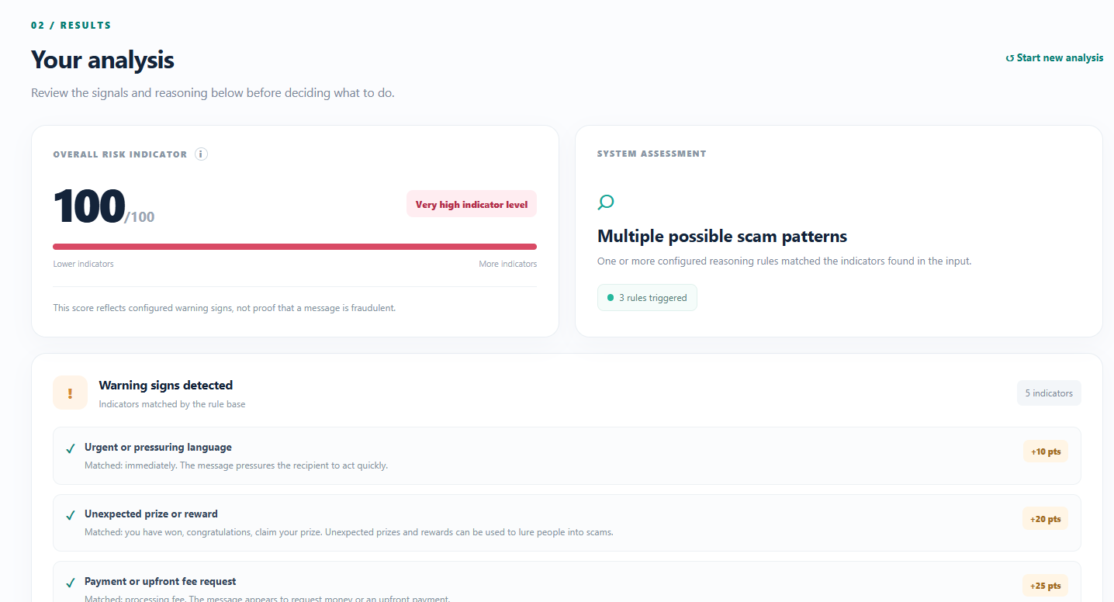
♧ Fundamentals of Artificial Intelligence
PROJECT DEMO
Demonstrates how the system analyses suspicious inputs, identifies warning signs, and generates risk assessments with safety recommendations.
7

Slide 8
♧ Fundamentals of Artificial Intelligence
FUTURE ENHANCEMENTS
ScamLens AI can be enhanced with advanced techniques to improve detection accuracy, adaptability, and user experience.
›
Multi-language: Support scam detection in multiple languages.
›
LR Integration: Add Linear Regression for risk prediction.
›
URL Analysis: Improve detection of malicious website links.
›
Updated Rules: Add new scam patterns regularly.
›
Better Accuracy: Test with larger datasets and improve risk assessment.
8

Slide 9

♧ Fundamentals of Artificial Intelligence
CONCLUSION
ScamLens AI demonstrates the application of artificial intelligence concepts in identifying and analysing potential online scams.
›
The system analyses suspicious messages, emails, and URLs to identify possible scam indicators.
›
Rule-based reasoning and risk scoring help classify inputs and provide understandable warnings.
›
The project promotes online safety by helping users recognize suspicious activities and make informed decisions.
9

